Slide 1
Ethno-Graphy
A Transdisciplinary Approach on the Adi Ganga

Slide 2
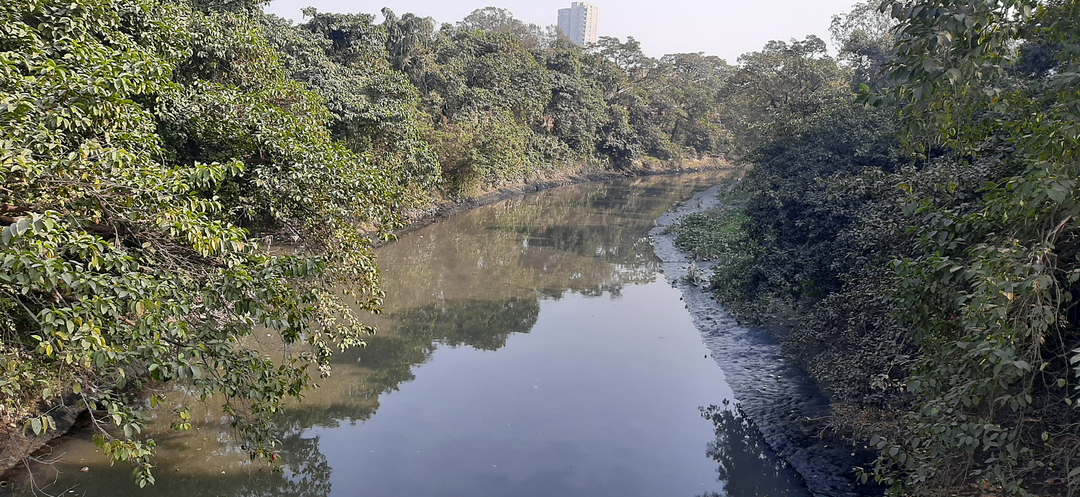
The River Adi Ganga
History
Ecology
Socioculture
Cartography
Geomorphology

Slide 3
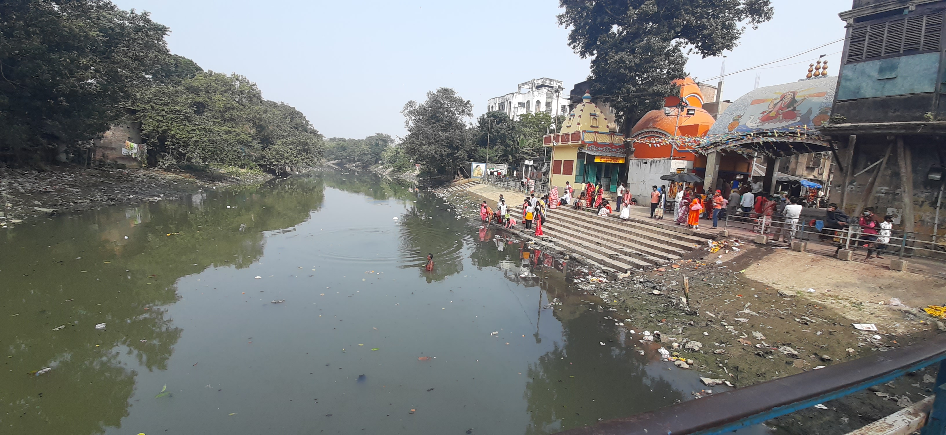
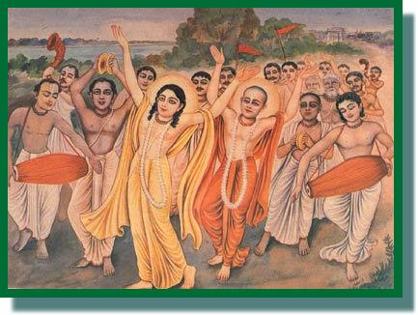
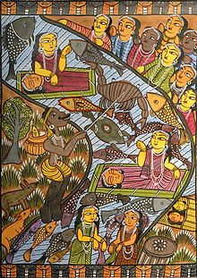
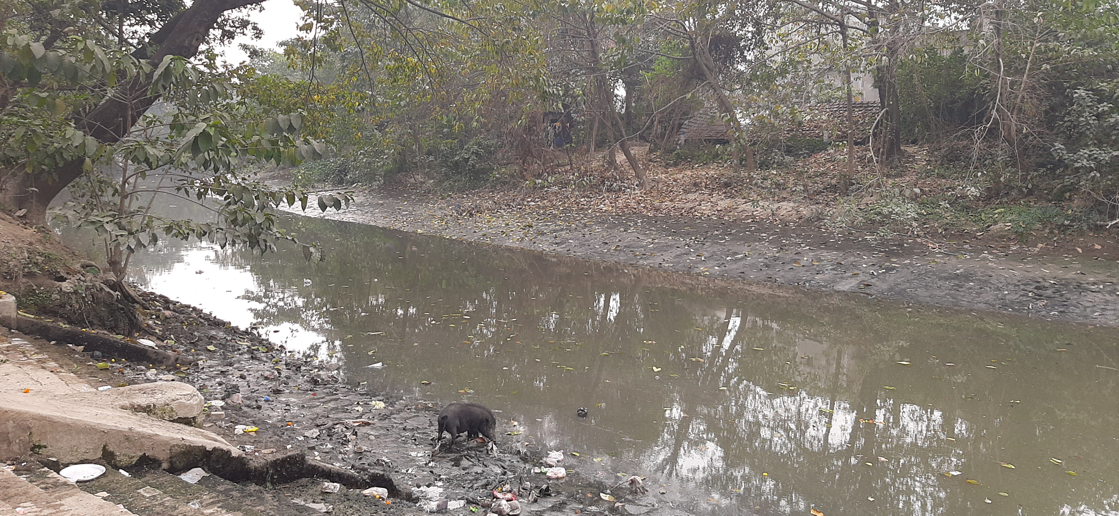
Historical Assemblages on the River Adi Ganga
River Adi Ganga, a distributary of River Hooghly, had been an important channel of Bengal Delta since the pre-colonial era, as a significant religious stream and also a major transportation route

Slide 4
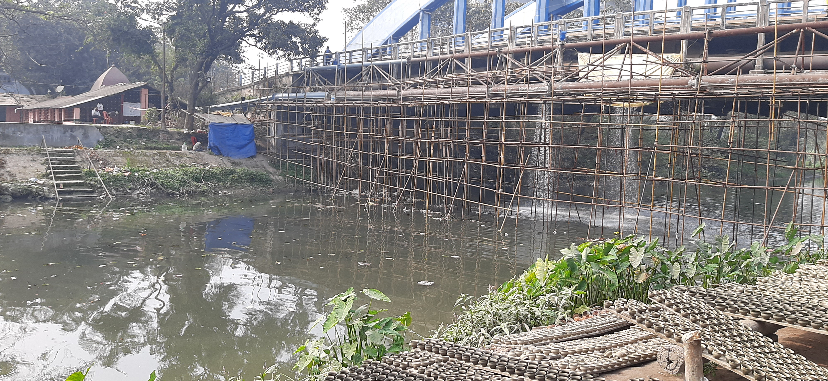
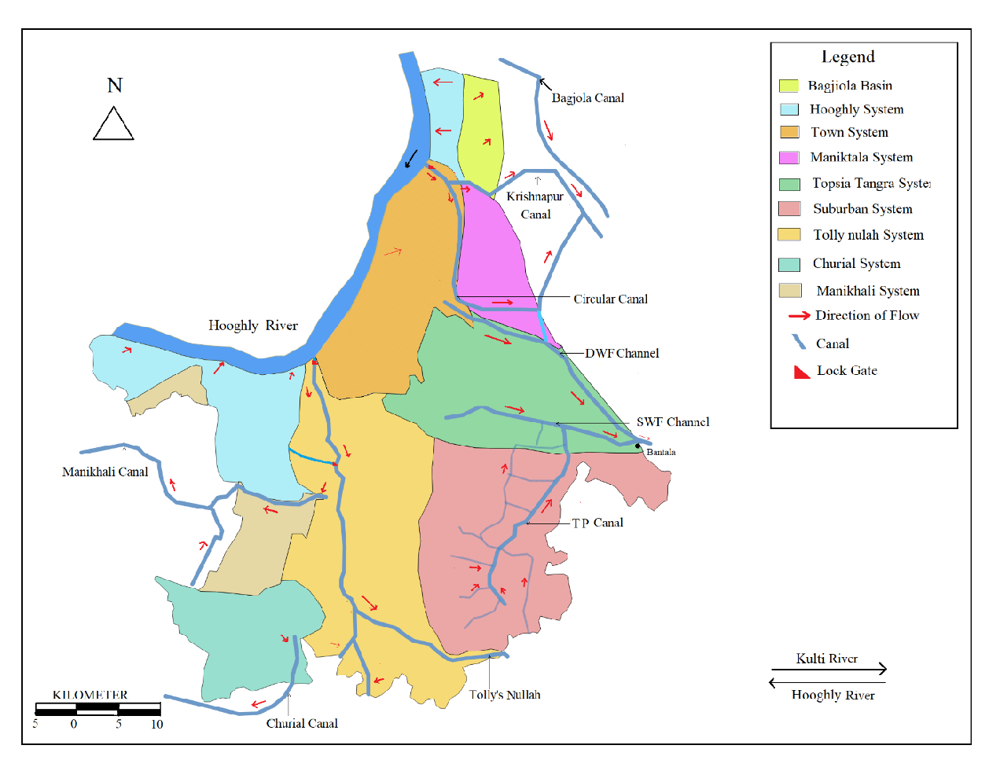
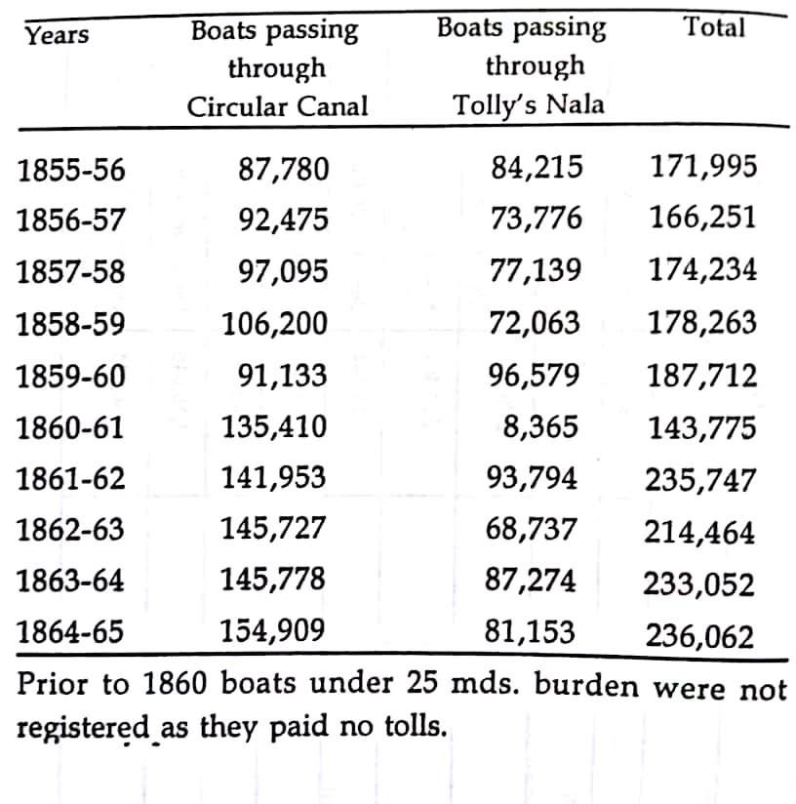
From Adi Ganga to Tolly’s Nullah
Drainage Systems of Kolkata
The advent of the British colonial rule and hydrology in the region saw the river’s transformation into a trade route and a drainage-sewerage channel with the rapid growth of Calcutta into a metropolis

Slide 5
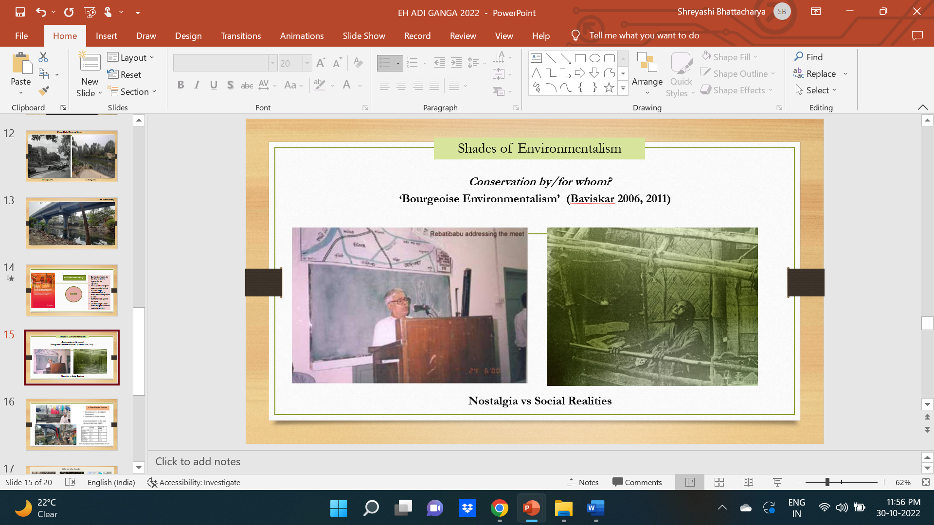
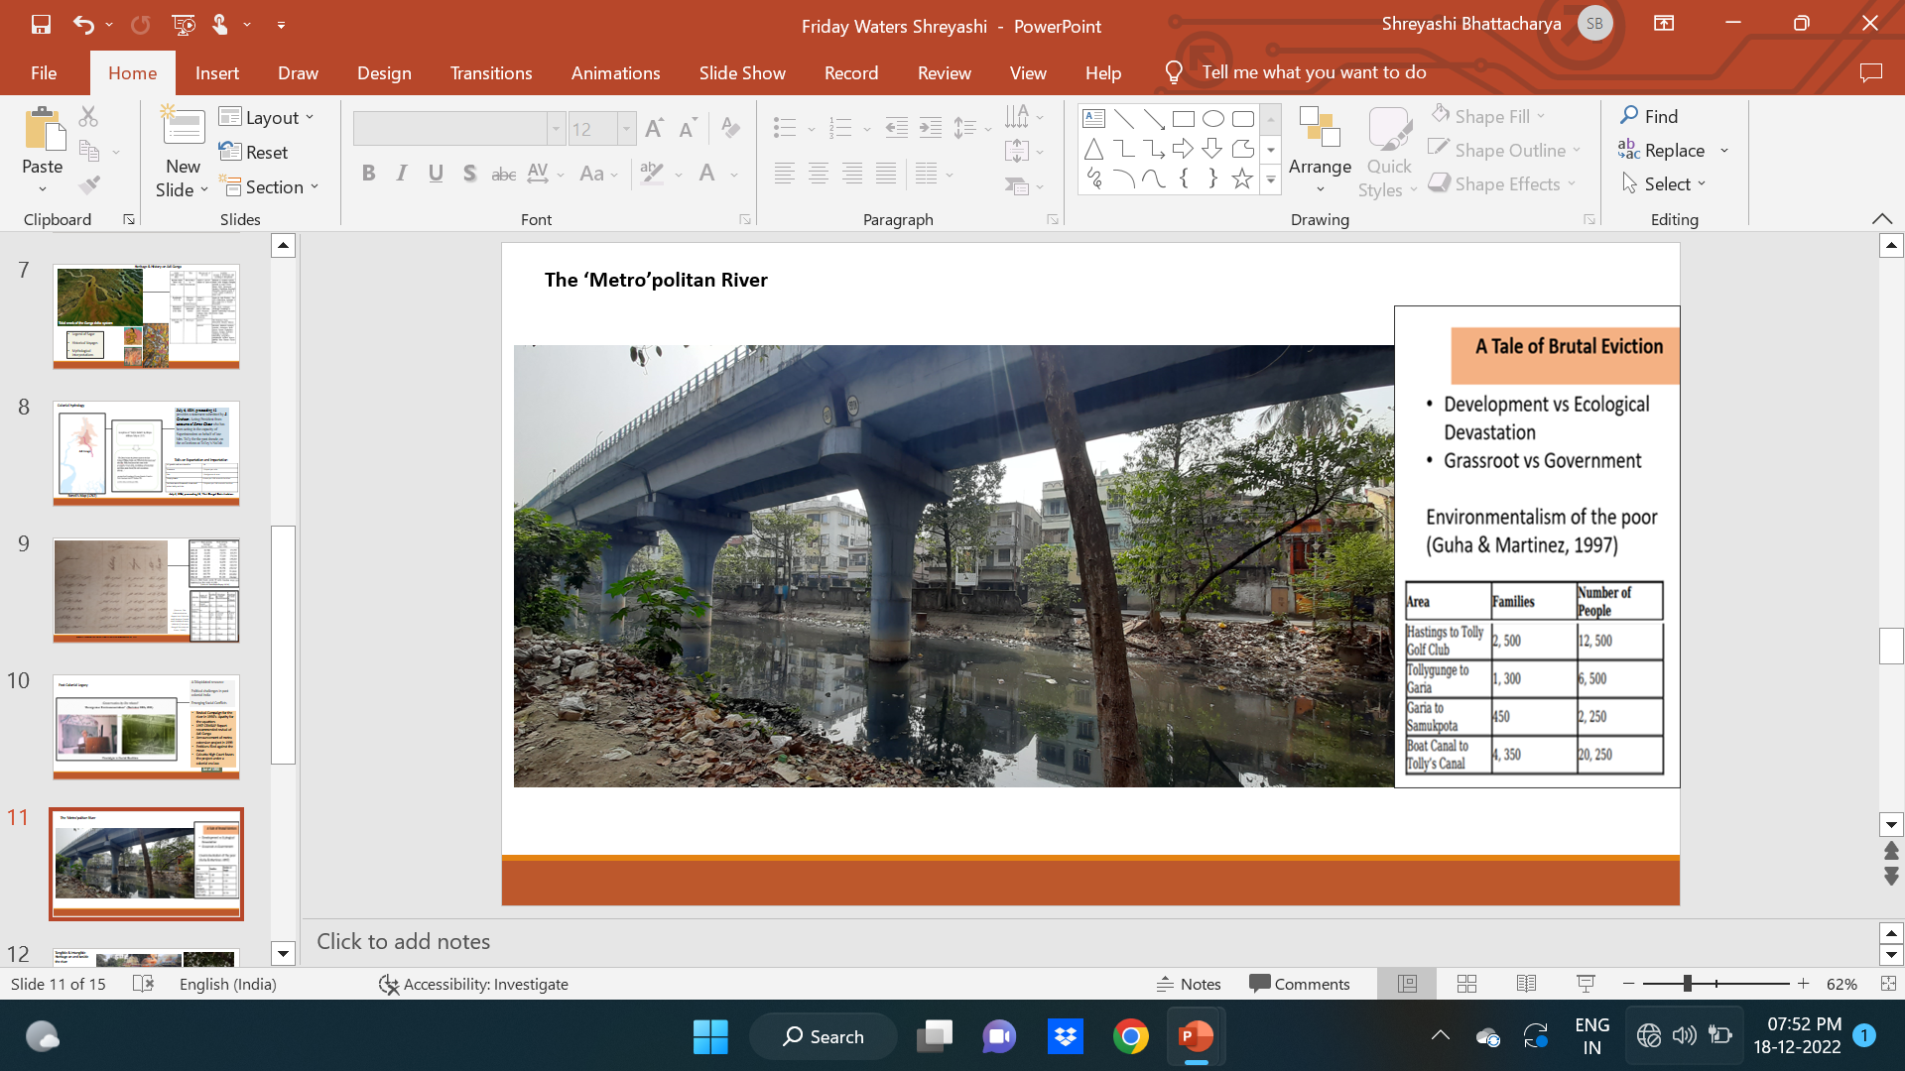
Post Colonial Identity
Post-independence, the river struggled with
the legacy of dated hydraulic mechanisms,
increasing untreated garbage accumulation on the banks, rising siltation and unchecked encroachment
Since the 1980’s, there was a rise in environmentalism surrounding the river between two sections- the ones who considered encroachers as the culprits and the others who believed that the encroachers had equal agency in river rejuvenation
Against all the debates on river conservation, state sanctioned the construction of the metro railway on a section of Adi Ganga’s stretch, which was considered the final nail in her coffin
Rebati Ranjan Bhattacharya
A squatter on Tolly Nullah
‘Metro’politan River

Slide 6
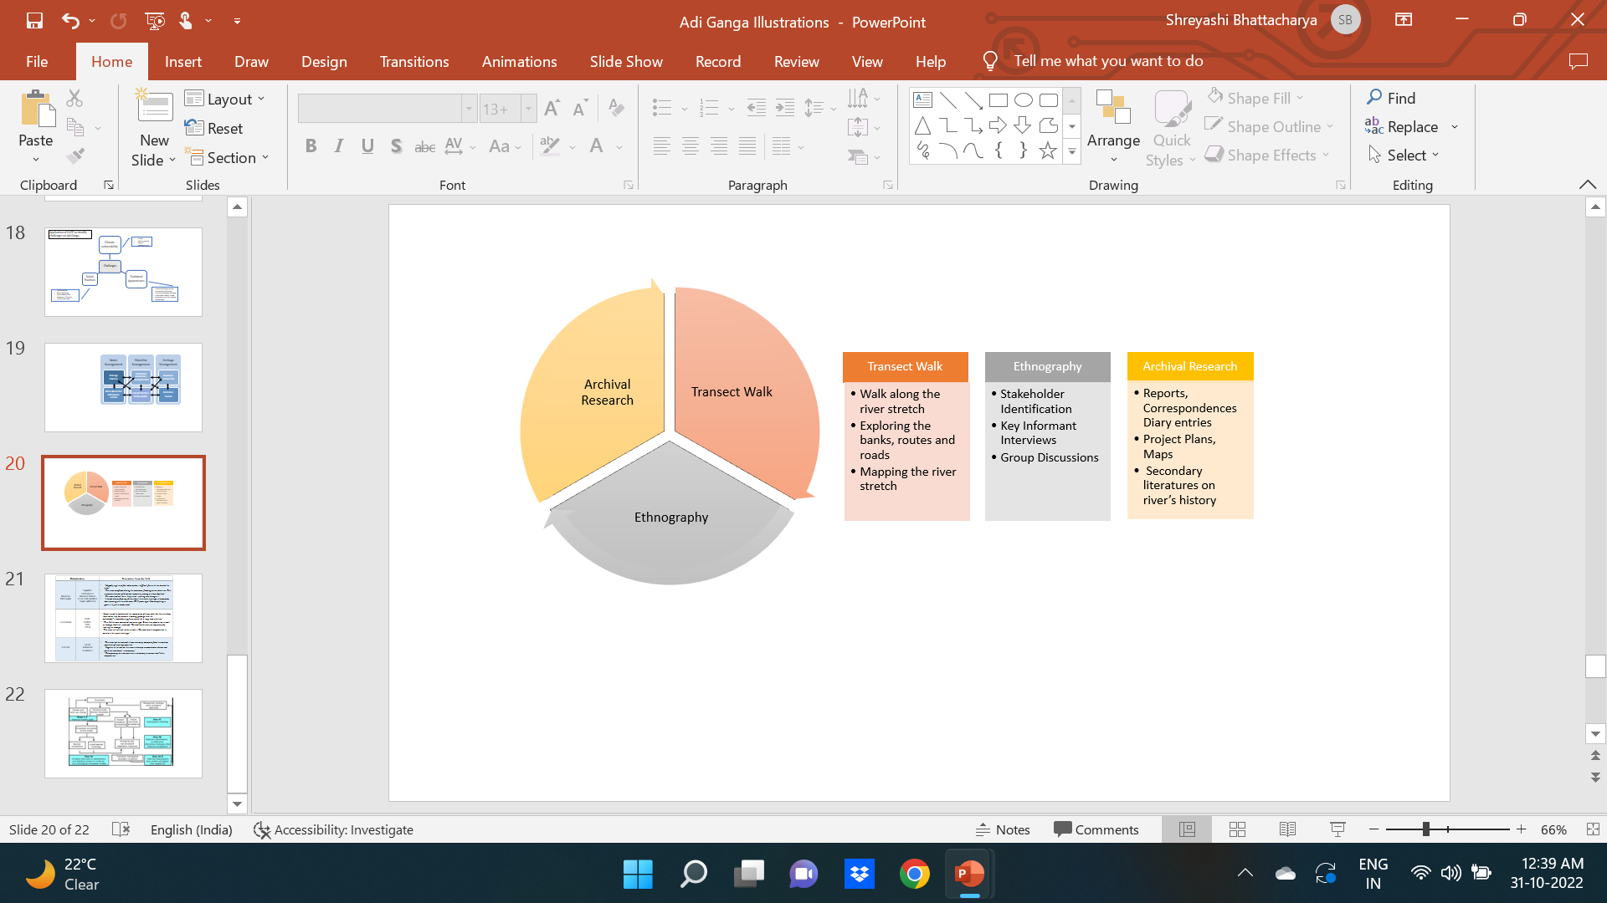
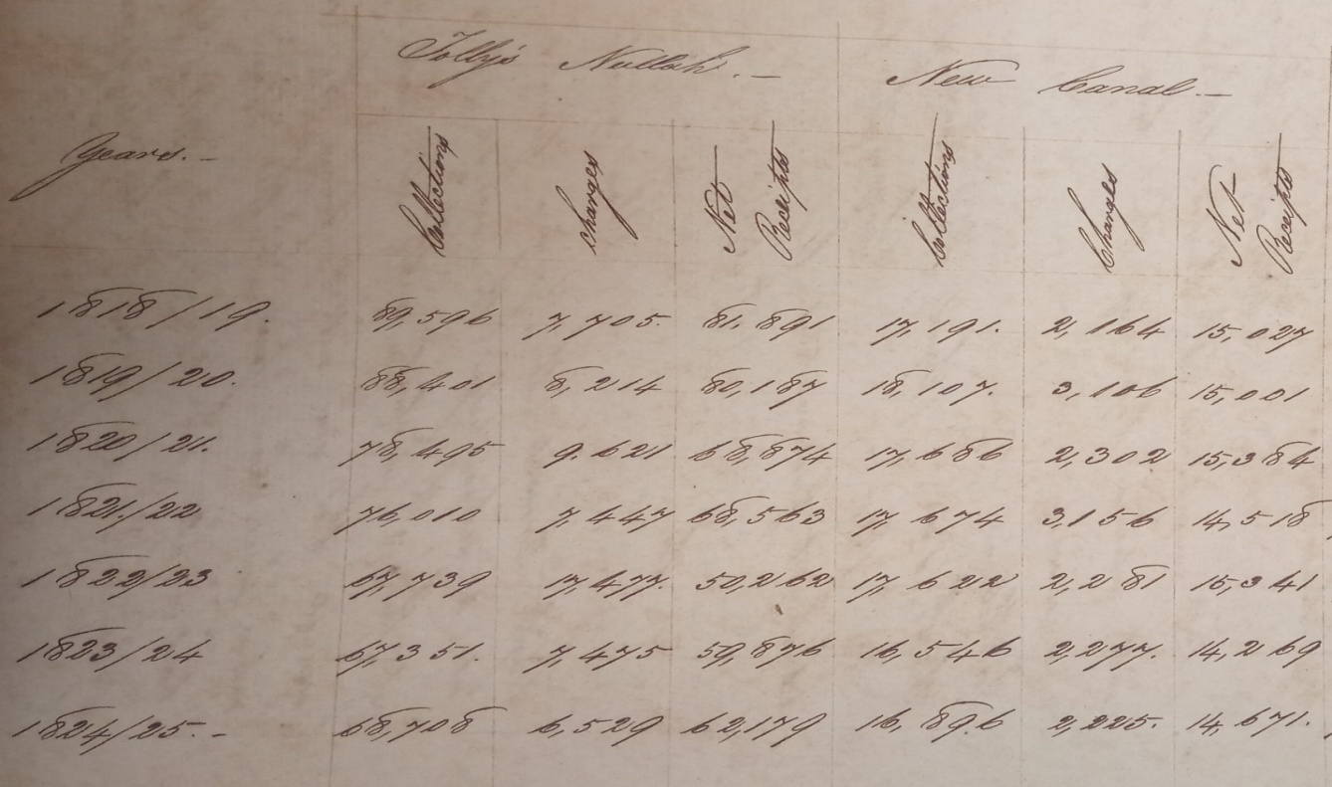
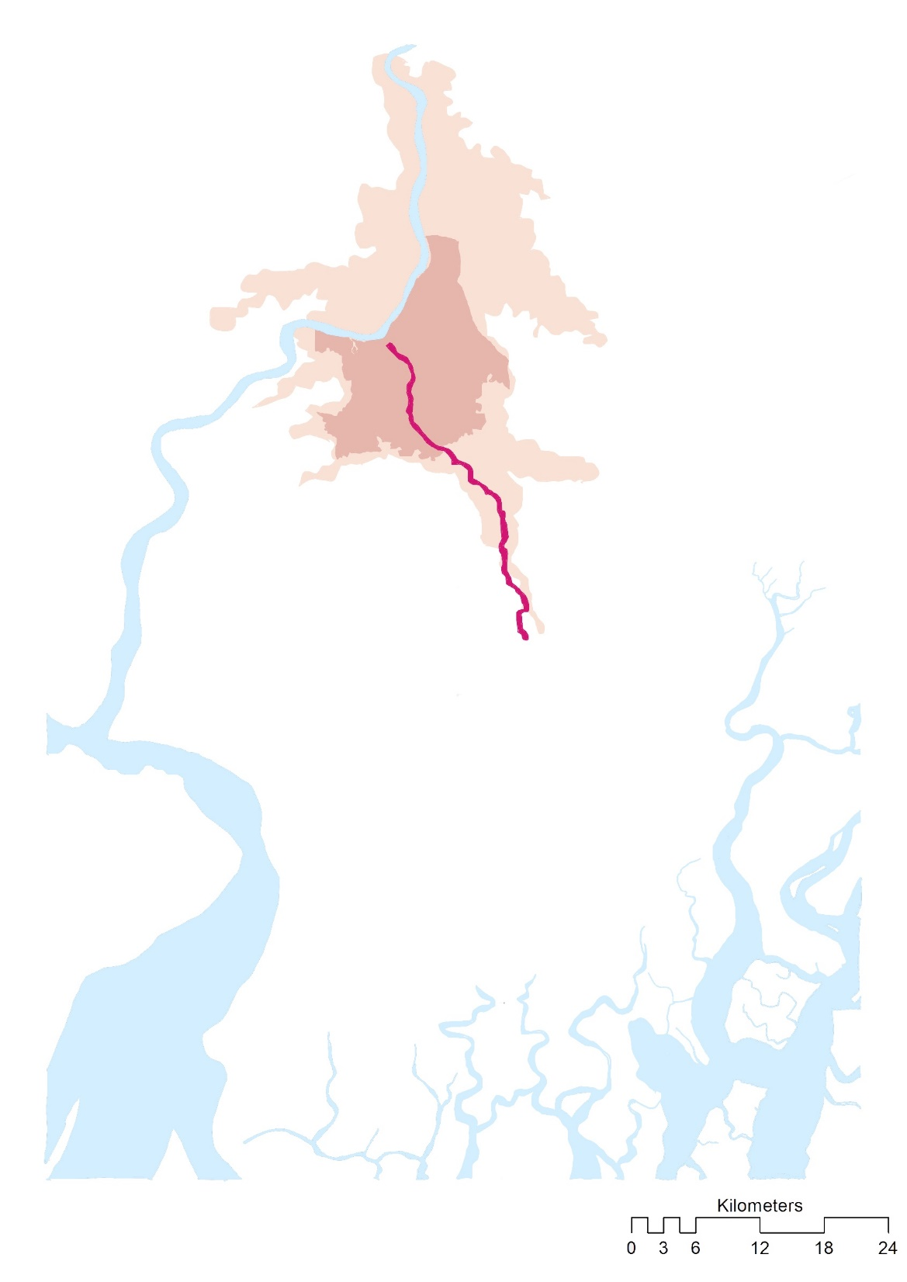
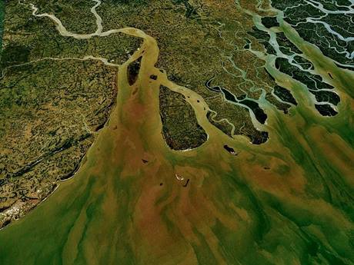
Annual revenue reports on Tolly Nullah, 1818-1825
Stakeholders |  | Narratives from the field
Shoreline Participants | Residents Business Owners Local Club members Temple authorities | “The river overflows during the monsoon, flooding entire localities. This increases chances of diseases, especially among us slum dwellers” “This was and will be a ‘holy river’, nothing can change it!” “I heard stories from my father about the river’s heritage…I remember boats passing on the river even 10-15 years ago. Now everything is gone…it’s just a sewer now.”
Government | KMC KMDA IWD CPCB | “Locals need to understand the importance of river, what do their children learn when they see parents throwing garbage into the waterbody?…implementing fines cannot be a long term solution” “This Nullah was excavated centuries ago! Since then population as well as sewage load has increased. We need better tools or new plans for treating the sewage”
Activists | NGOs Journalists Academics | “The river can be revived…there are many examples from the western countries of river rejuvenation’ “Regular initiatives on the river’s cleanup, encroachment drives and pollution abatement is necessary” “Transparency on river policies is necessary to ensure local-state cooperation’
Rennell’s Map of Adi Ganga (1767)
Tidal Creek of Ganga Delta System

Slide 7
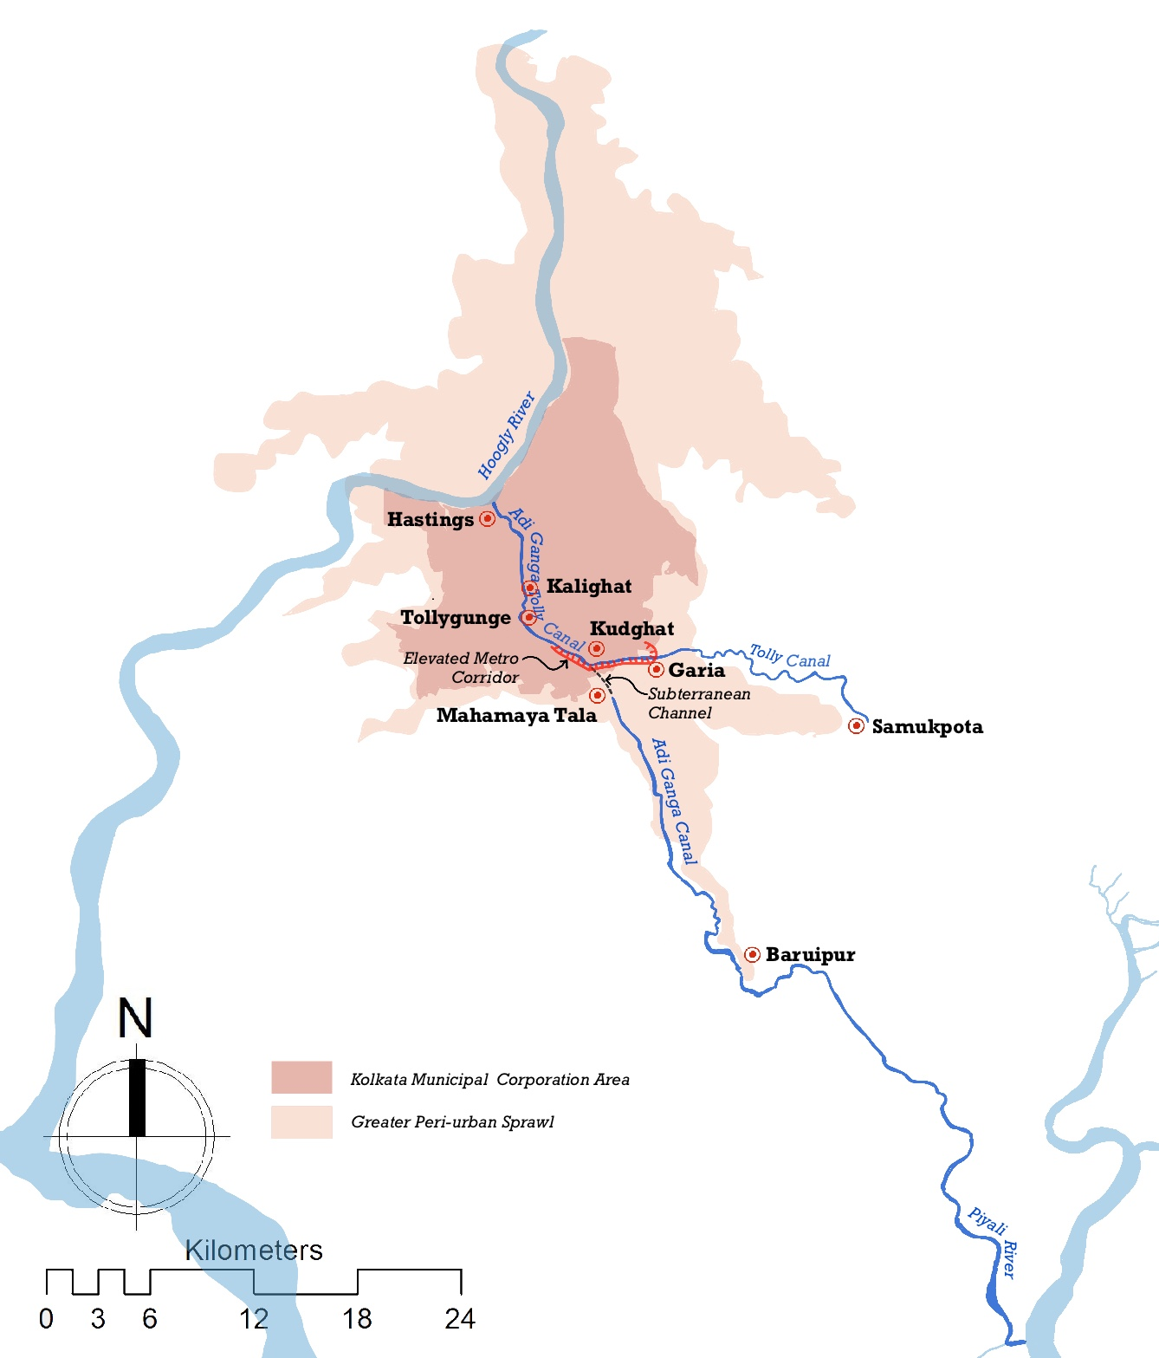
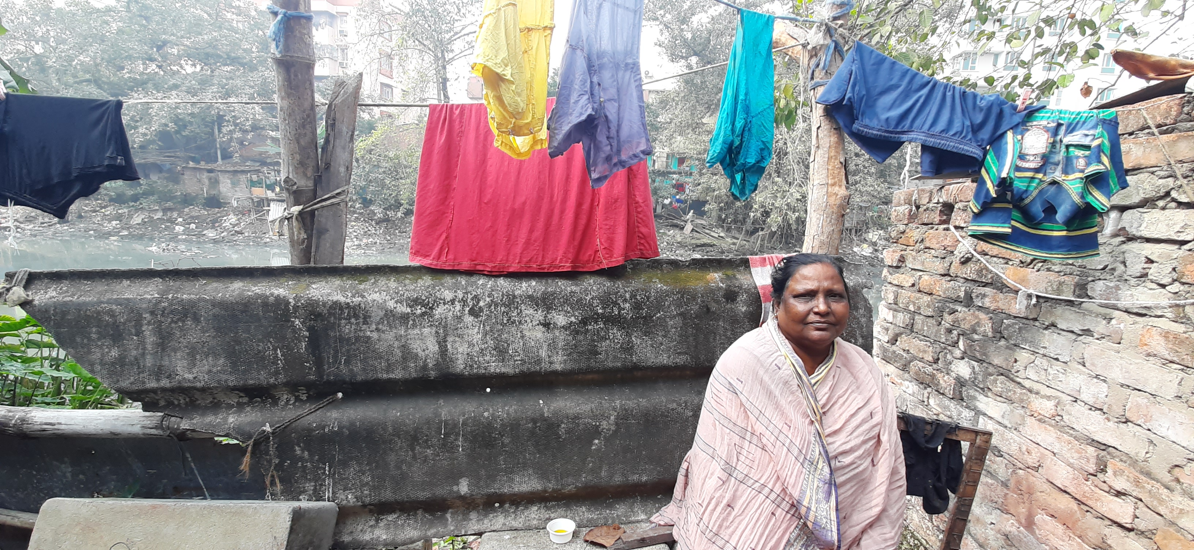
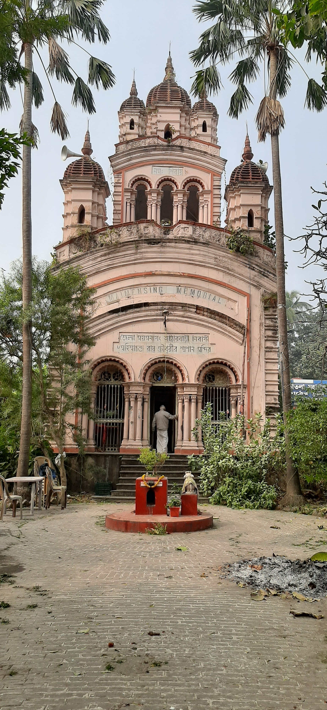
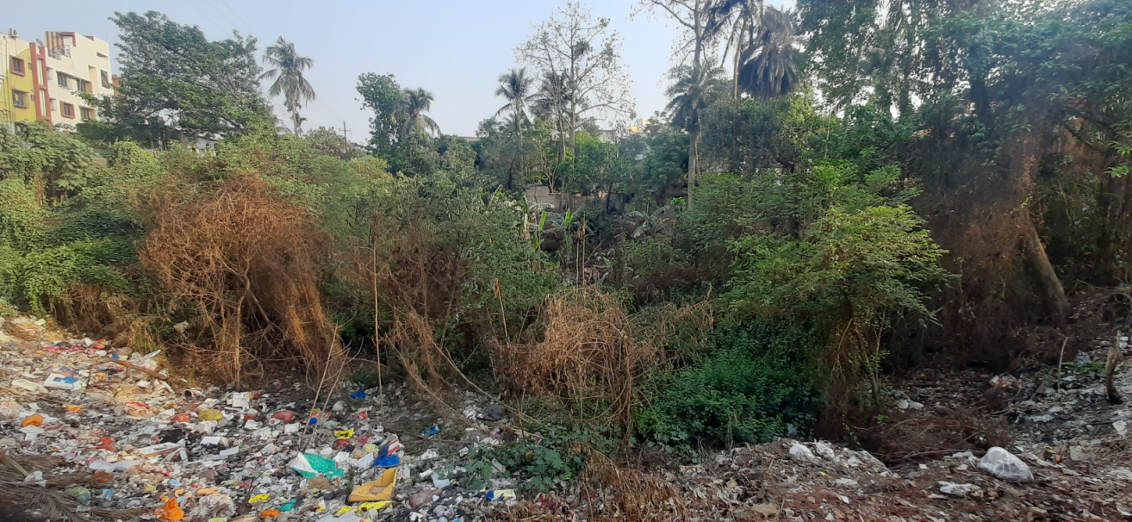
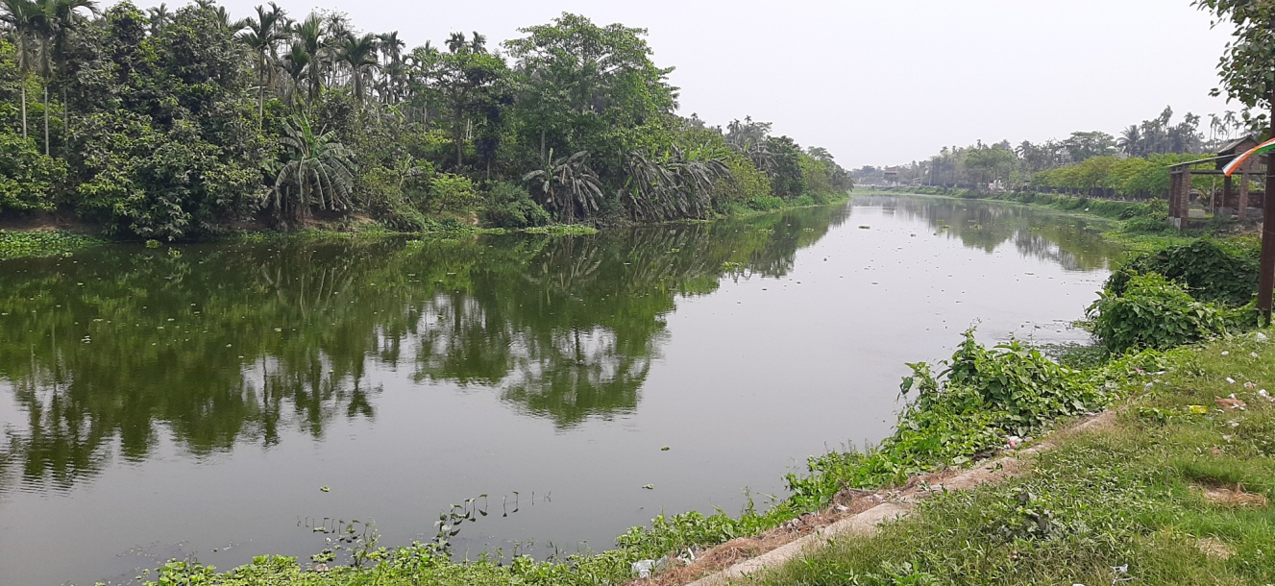
Adi Ganga, 2021
Not only a line on the map
Survival on the banks
Old temples on the ghats
The structures, the stories, the downfall and resurgence…
where are they on a map?
Disappearing into a paleochannel
Remerging in a vibrant form

Slide 8
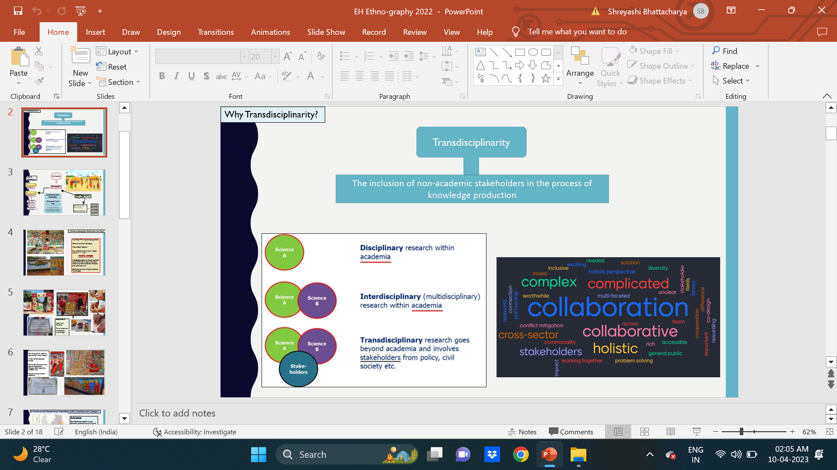
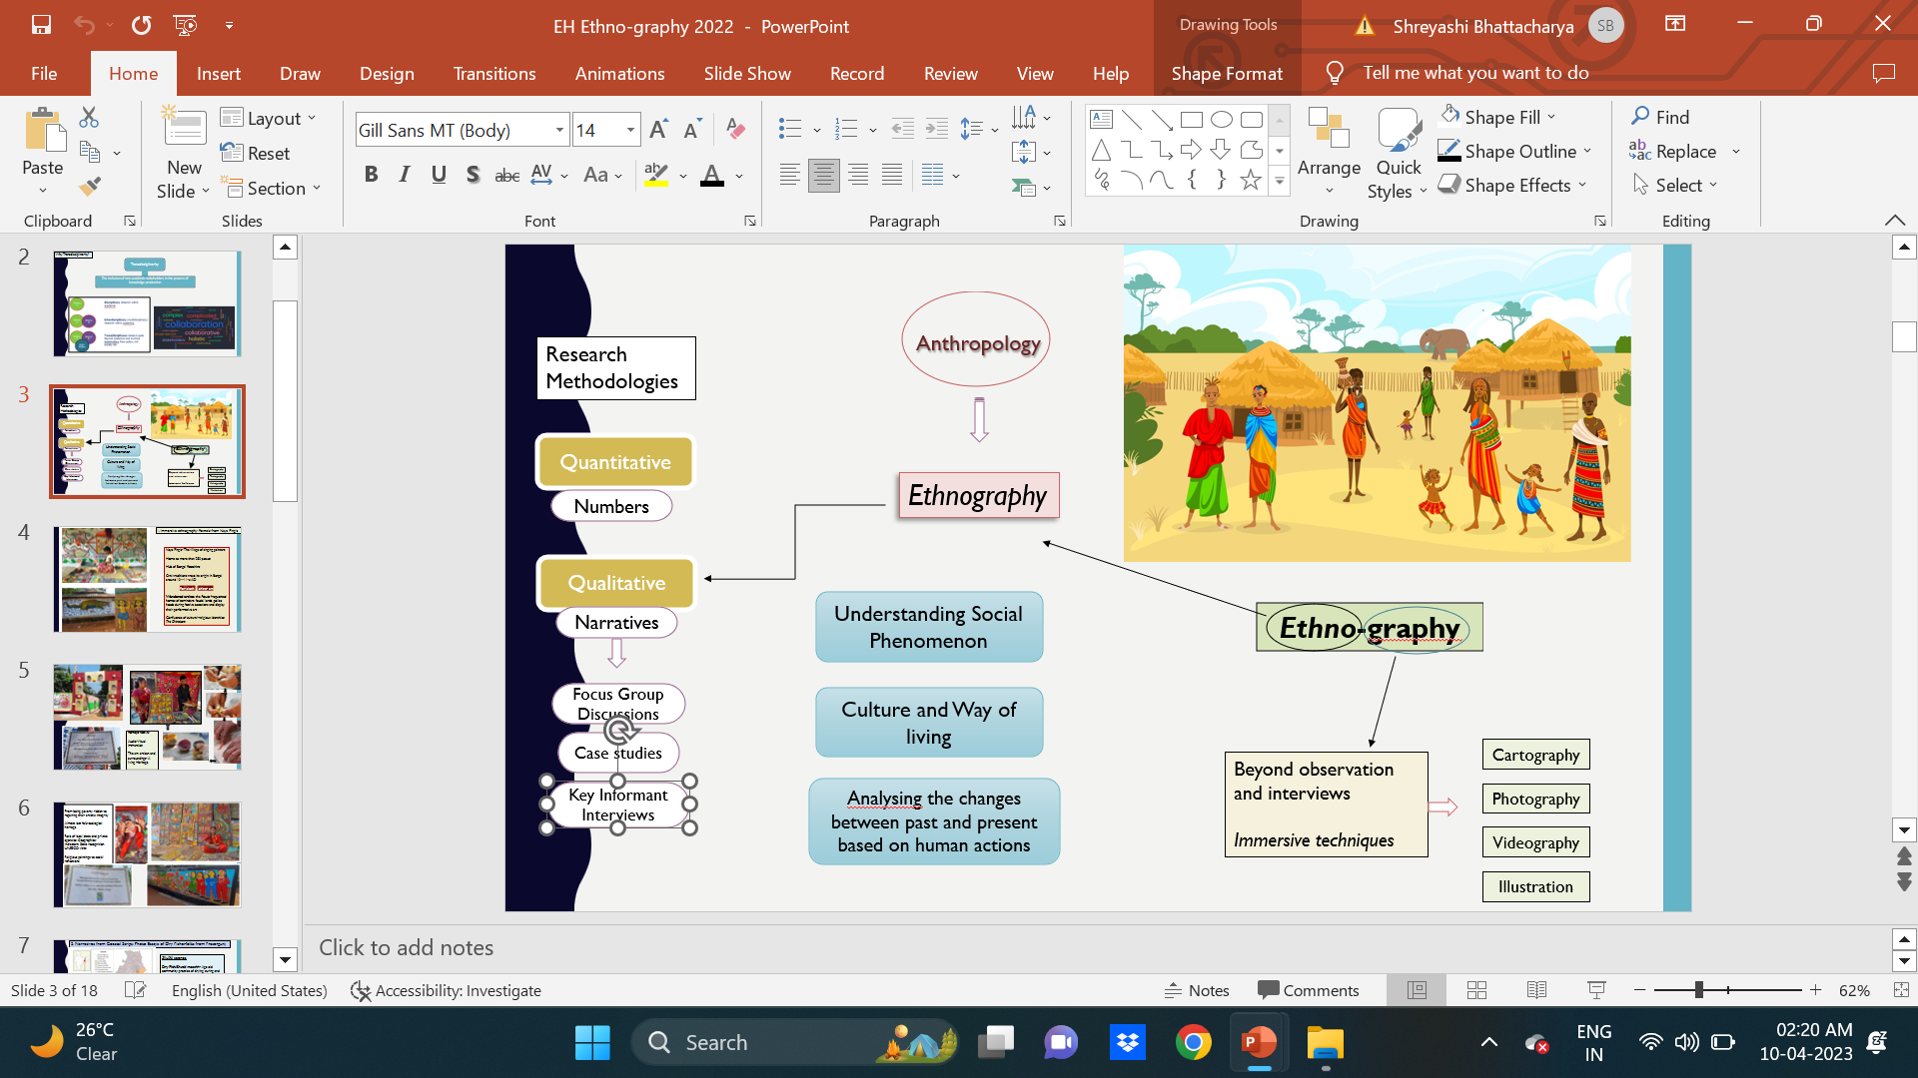

Classical Ethnography
‘Ethno’
Narratives
Focus Group Discussions
Case studies
Key Informant Interviews
‘Graphy’
Archival Research
Qualitative Research
Classical ethnography
+
critically engaging and innovative methods
Ethno-graphy
Archival datasets & Secondary Literature
Ethnography and transect walks

Slide 9
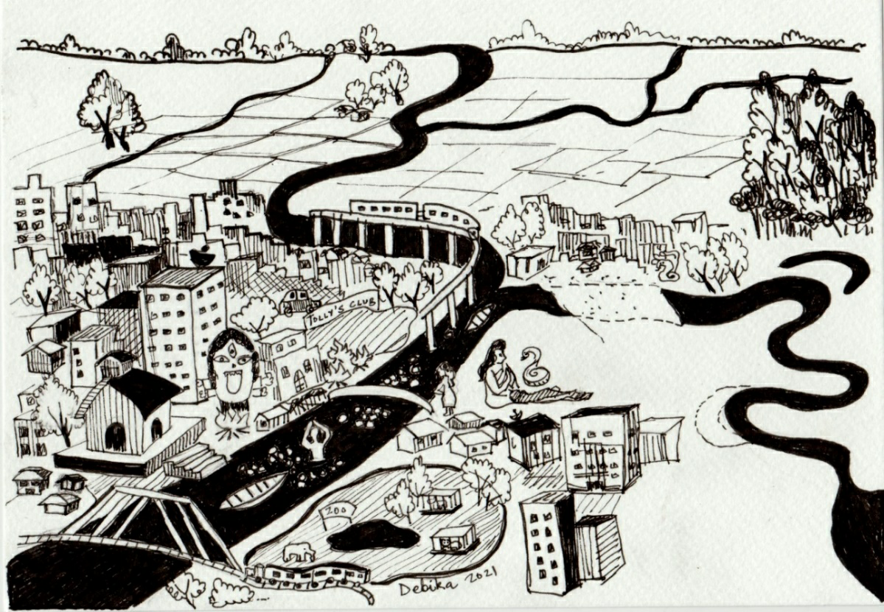

Projecting the river route
Integrating cartography, history, transect walks and in-depth ethnography

Slide 10
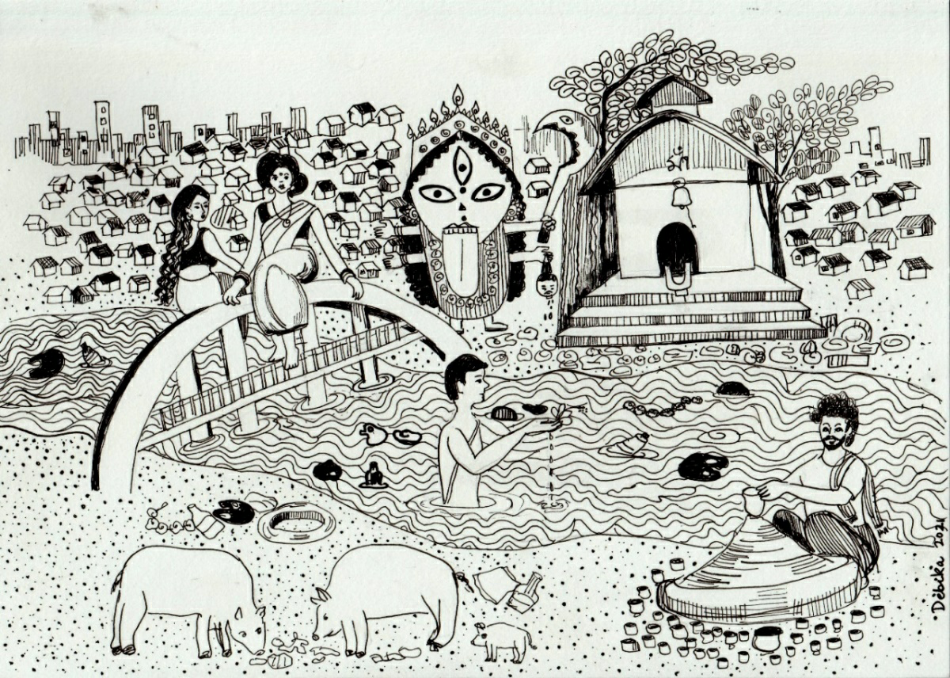
Kalighat-Adi Ganga on paper
A culturalscape on shorelines
Livelihood on the banks
Evolving urbanity
Sacred-Sin duality

Slide 11
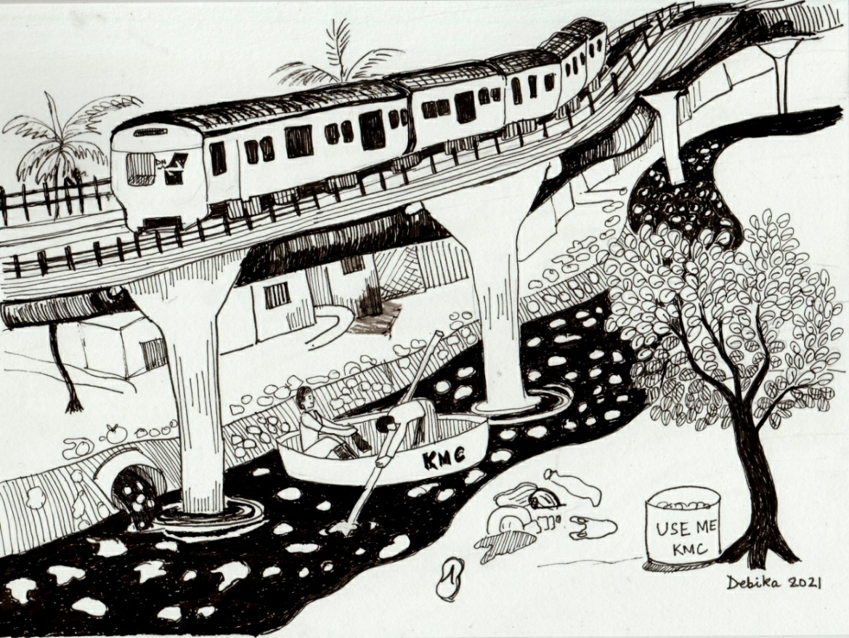
The Metroscape
Pillared hydroscape
Changing demography
Pollution-maintenance narratives

Slide 12
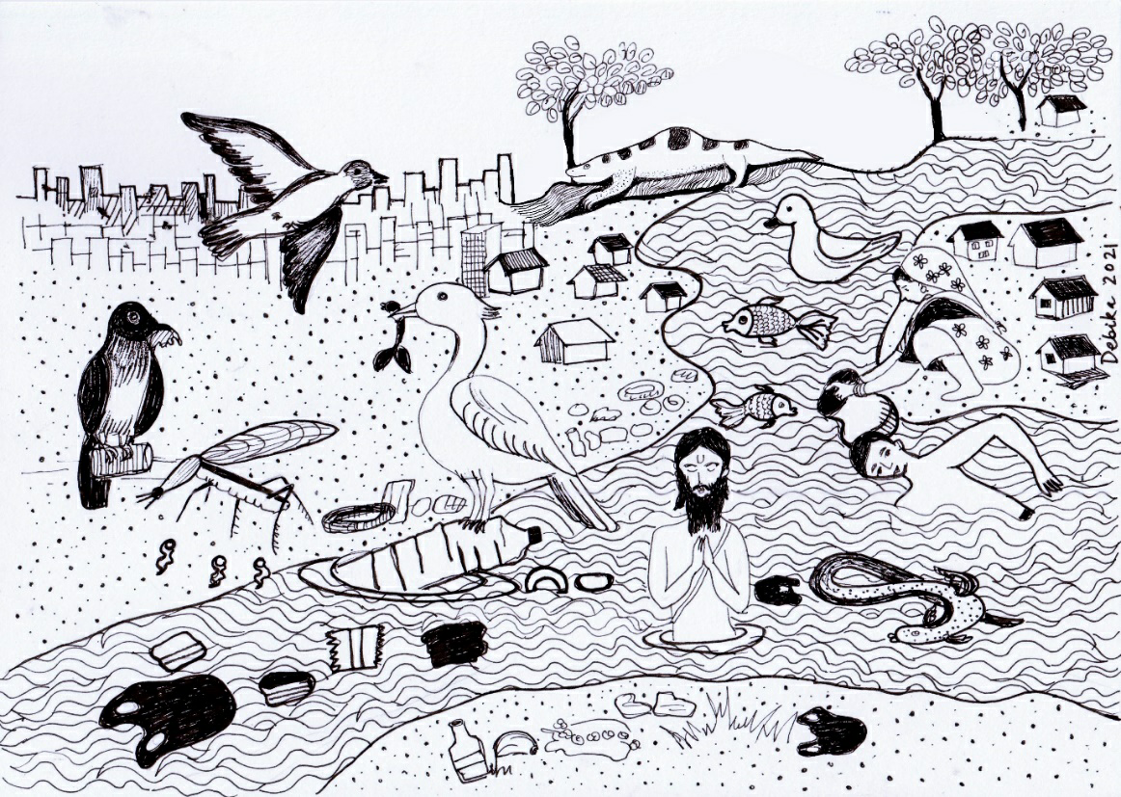
Whose River?
Human-non human voices
Integration of ecological-social phenomenon
Need for multistakeholder understanding and collaboration

